Slide 1
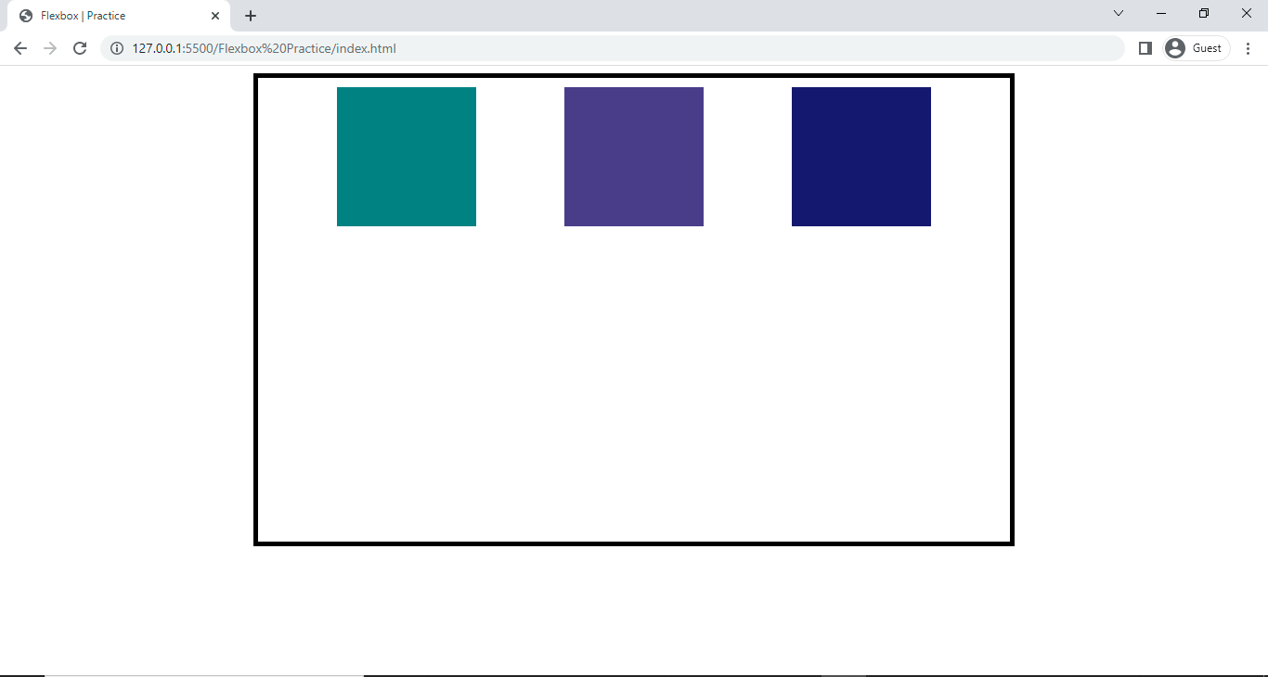
Flexbox Practice
Practice 1

Slide 2
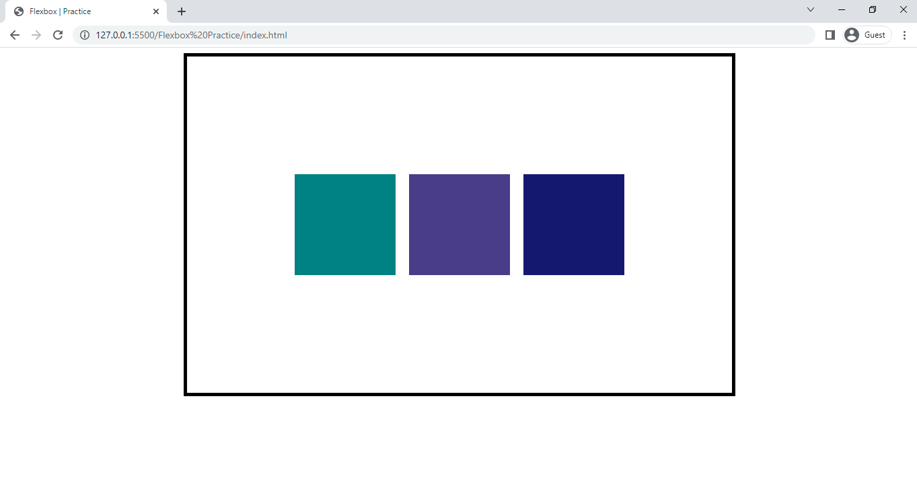
Flexbox Practice
Practice 2

Slide 3
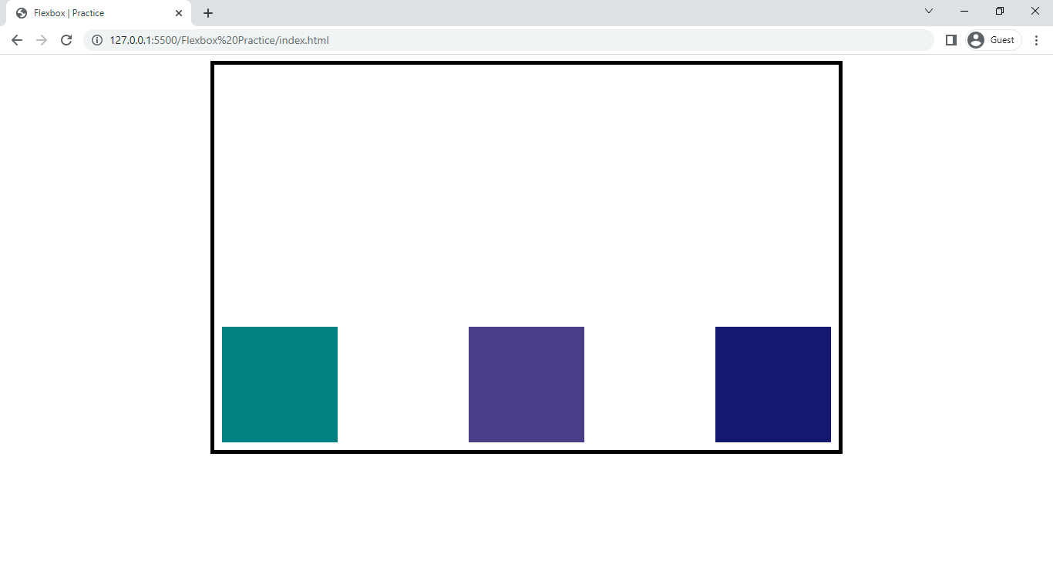
Flexbox Practice
Practice 3

Slide 4

Flexbox Practice
Practice 4

Slide 5
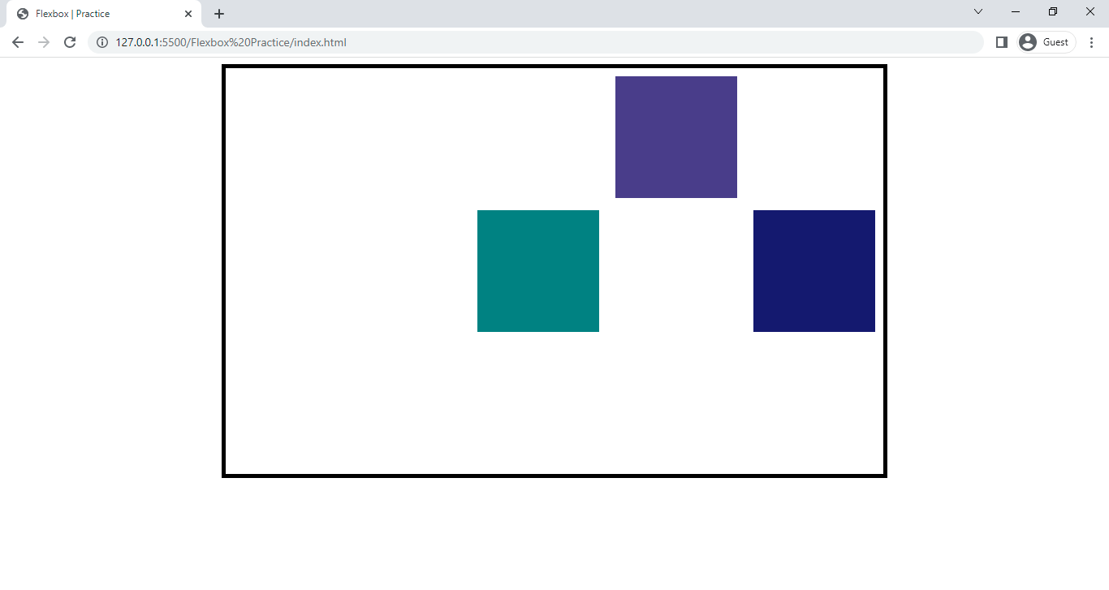
Flexbox Practice
Practice 5

Slide 6
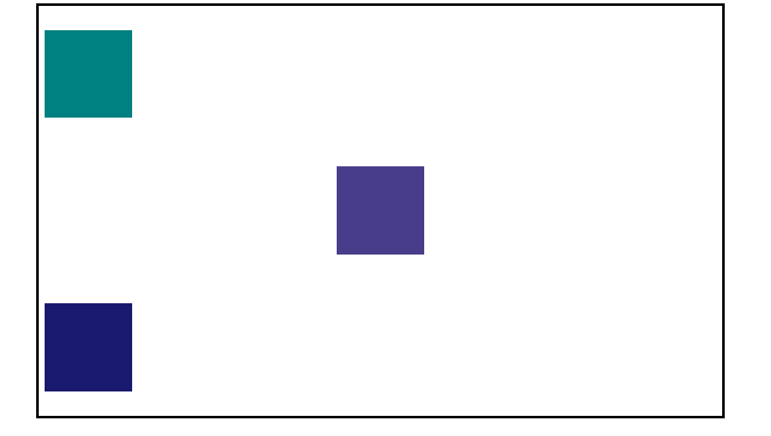
Flexbox Practice
Practice 6

Slide 7

Flexbox Practice
Practice 7

Slide 8
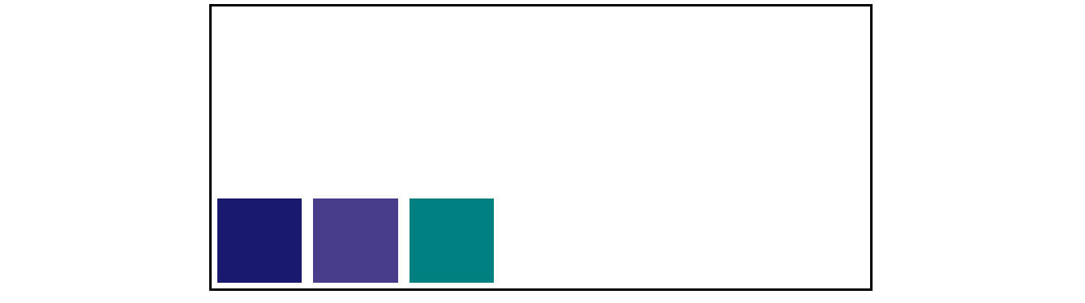
Flexbox Practice
Practice 8
Use row-reverse

Slide 9

Flexbox Practice
Practice 9
Use column-reverse

